Slide 1

Ethical Considerations of Contrasts in the Statistical Modeling of Medical Equity
Nicole Chicoine, DO, MPH & Dwight Barry, PhD
Seattle Children’s Hospital
Seattle, WA, USA
Notes:
Hello, and thanks for attending our lightning talk. My name is Dwight Barry, and I am a Principal Data Scientist at Seattle Children’s Hospital, a 400-bed pediatric hospital in Seattle, WA, USA. Our talk will discuss how ethical choices are implicitly embedded in regression analyses, using a recent example from our surgery department. In short, how your categorical variables are coded for analysis can influence the inferences you make from your results.

Slide 2
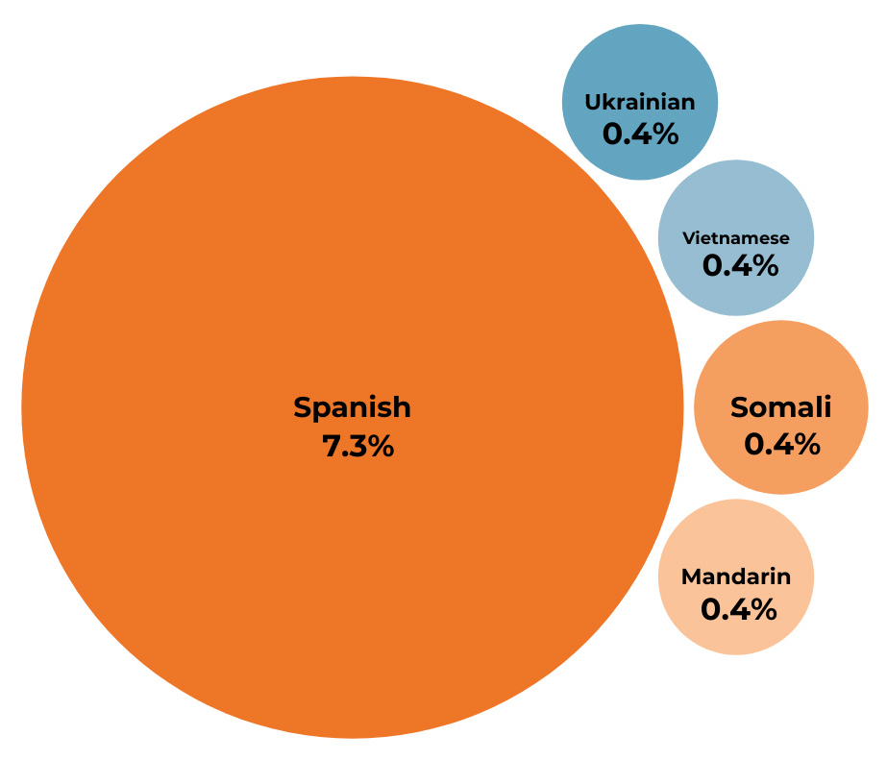

Annually > 79,000 interpreted encounters (from > 525,000)
All Spanish OR, 2025
Notes:
Our hospital system sees more than half a million patient visits each year, of which more than 79 thousand require translation between English and the patient and family’s preferred language for care. More than 130 languages are spoken by our patient population; of these, the most common is Spanish. As a result, we’ve started our first all-Spanish-speaking operating room this year. Interpretations are carried out both in person with in-house interpreters and through video exchanges with interpretation companies.

Slide 3
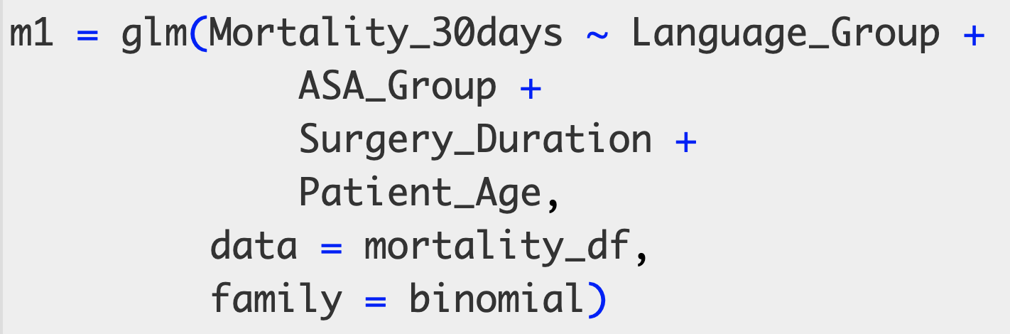
Quality Improvement and Patient Safety Question: do surgery patients/families with a language for care other than English have worse outcomes?
Notes:
At our hospital, we are always trying to ensure that we treat everyone equally, and that outcomes are as equitable as possible. For example, our surgery department was interested in determining whether there were differences in outcomes, such as 30-day mortality and serious adverse events, after surgeries. A straightforward logistic regression could look at the patient’s language group as the exposure, adjusted by variables that describe surgery complexity.

Slide 4

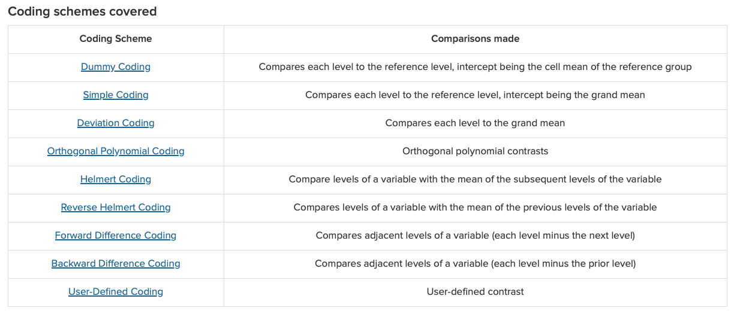

Contrasts and Coding schemes are often synonyms for the practice of converting categorical variables into a matrix of numeric values in a regression model (esp. in ).
https://stats.oarc.ucla.edu/r/library/r-library-contrast-coding-systems-for-categorical-variables/
Notes:
To learn about our exposure variable, the patient’s language group, we should first understand that coding schemes are an integral and usually implicit part of a regression model.
The UCLA stats pages have a great reference on regression coding schemes in R. In our experience, we find that while statisticians are usually aware that coding schemes exist, and that they are a required part of a regression model, clinicians, data analysts, and computer-science oriented data scientists are not.
Contrasts usually refer to differences between regression coefficients of interest, but for likely for historical reasons, contrasts is the name of the R function that shows you how categorical variables are coded in the model. So contrasts and coding schemes are synonyms; and if you are a computer scientist, you might know this practice as one-hot encoding. In this talk, we will only explore three coding schemes: treatment contrasts, sum contrasts, and weighted effect coding.

Slide 5
Quality Improvement and Patient Safety Question: do surgery patients/families with a language for care other than English have worse outcomes?
Notes:
So how do coding schemes play out in applied regression, when you’re trying to answers questions involving equity?

Slide 6
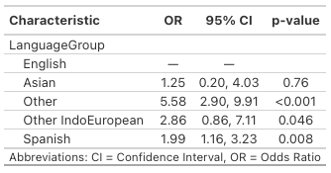
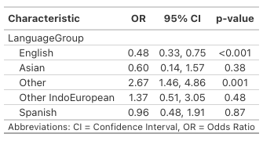
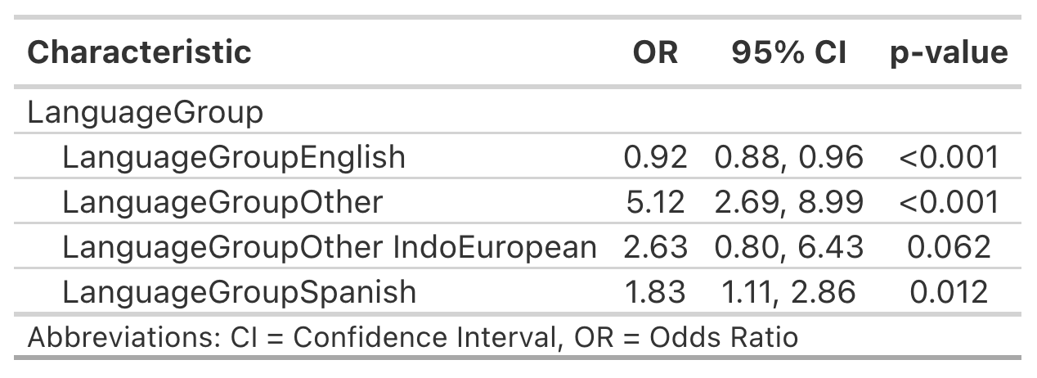
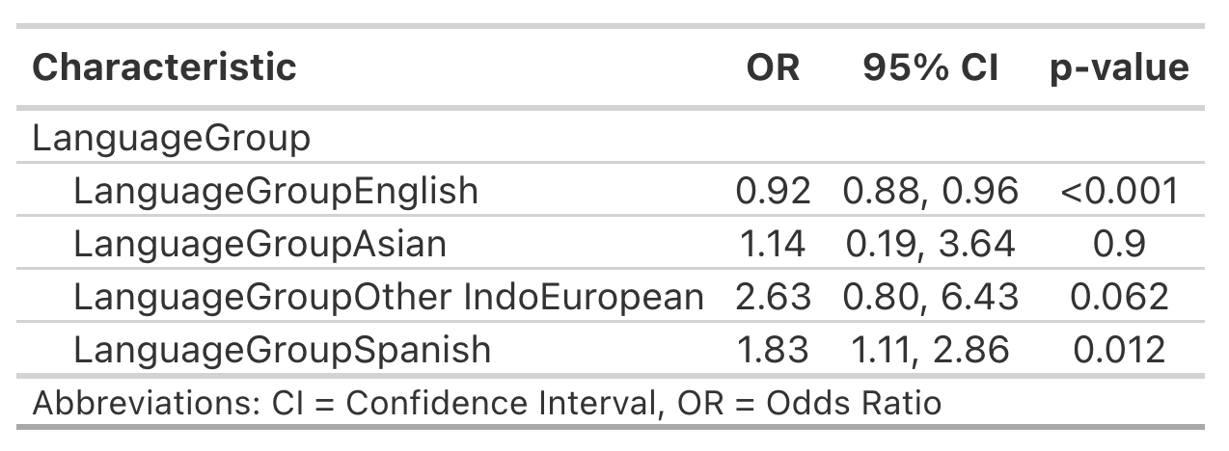
The results:
Treatment Contrasts
Sum Contrasts
Weighted Effect Contrasts
Tables created with gtsummary::tbl_regression()
Notes:
Using each coding scheme, the results of the logistic regression model are shown here. The coefficients exponentiated to display odds ratios. Some results you see here are clearly because of small n, but I would like you to draw your attention specifically to outcomes for the Spanish speaking patients.

Slide 7
The results:
Treatment Contrasts
Sum Contrasts
Weighted Effect Contrasts
Tables created with gtsummary::tbl_regression()
Notes:
Two of the three results for Spanish speakers are statistically significant, while one is not. Those two significant models suggest that the Spanish group has almost twice the odds of a bad outcome!

Slide 8
Which contrast/coding scheme is correct?
Treatment Contrasts
Sum Contrasts
Weighted Effect Contrasts
Tables created with gtsummary::tbl_regression()
Notes:
So at this point, you might be asking yourself, which coding scheme is correct?

Slide 9
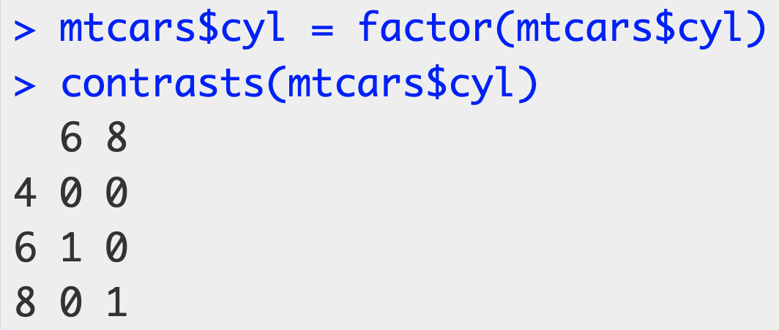
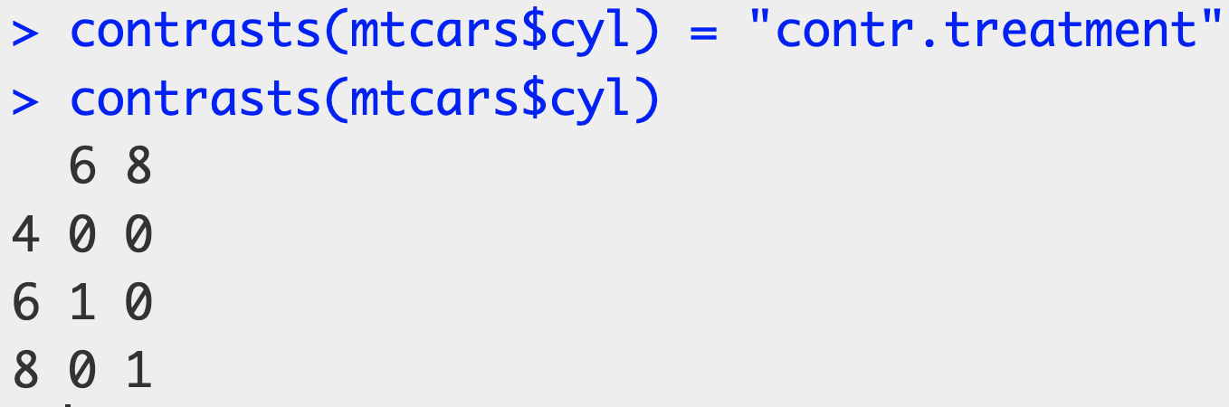
The default in is dummy coding, aka treatment coding, aka treatment contrasts.
Notes:
To explore this question, we'll look at each coding scheme in turn, using a simple example.
R’s default coding scheme for regression is called a treatment contrast. In the mtcars dataset, if you wanted to see the simple relationship between miles per gallon and the car engine’s cylinders (4, 6, or 8), the lm function will automatically set up the coding scheme in this way, where each level of a factor will be compared against a reference level (in this case, a 4-cylinder engine). This is called a treatment contrast because traditionally the reference level would be the control level in a controlled experiment.
You can see (or set) the coding scheme matrix with the contrasts function in R.

Slide 10
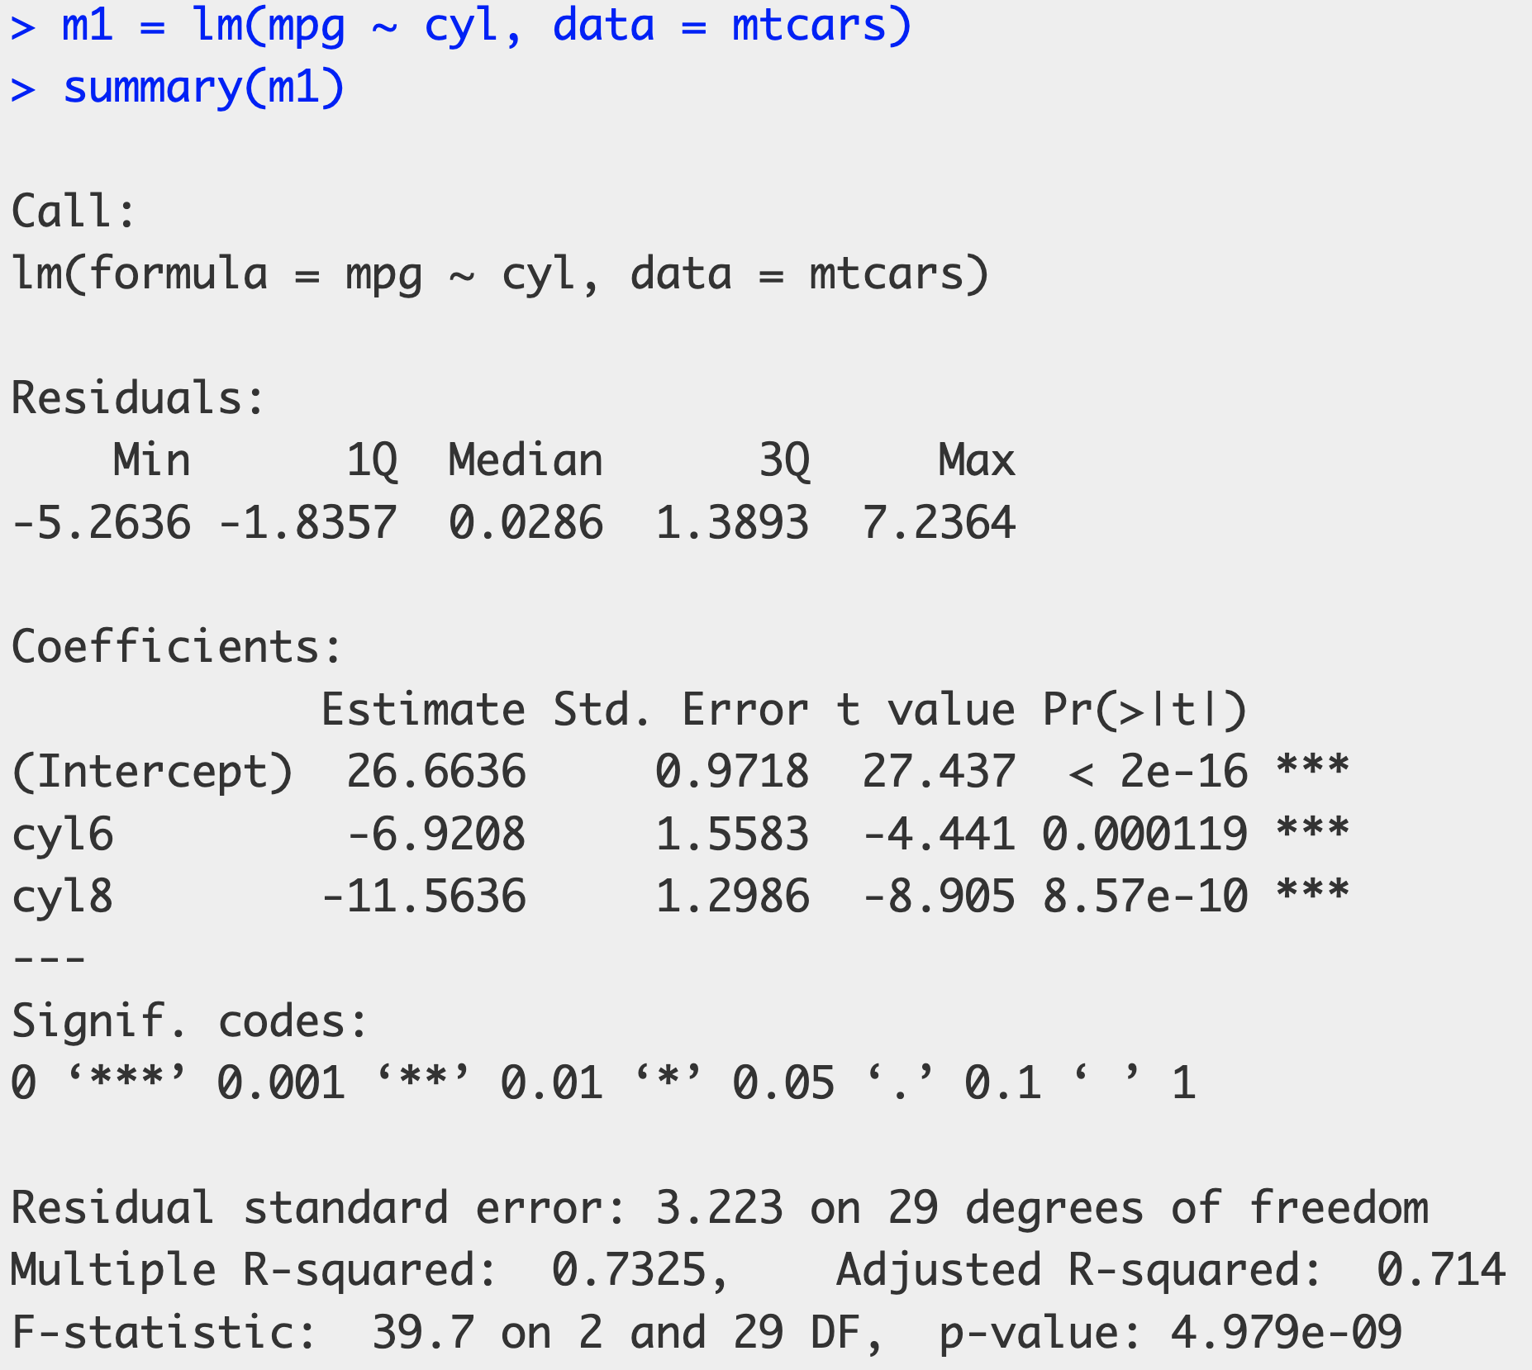
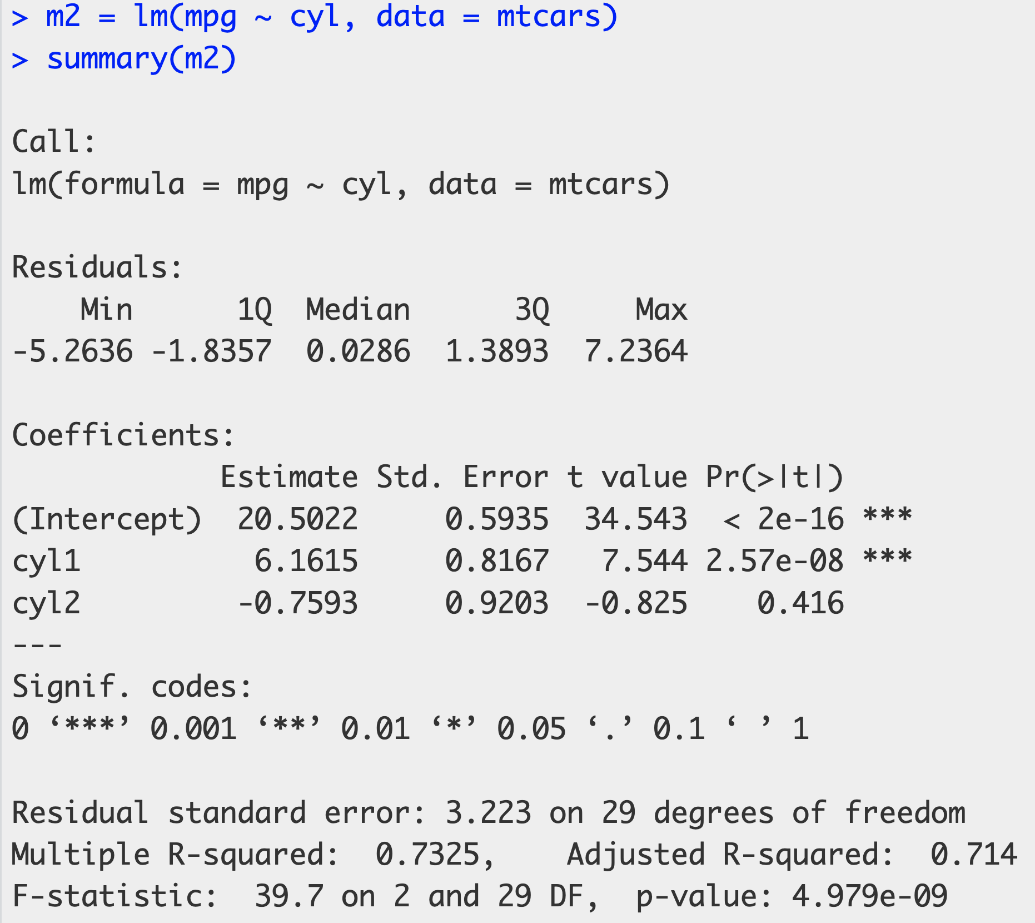
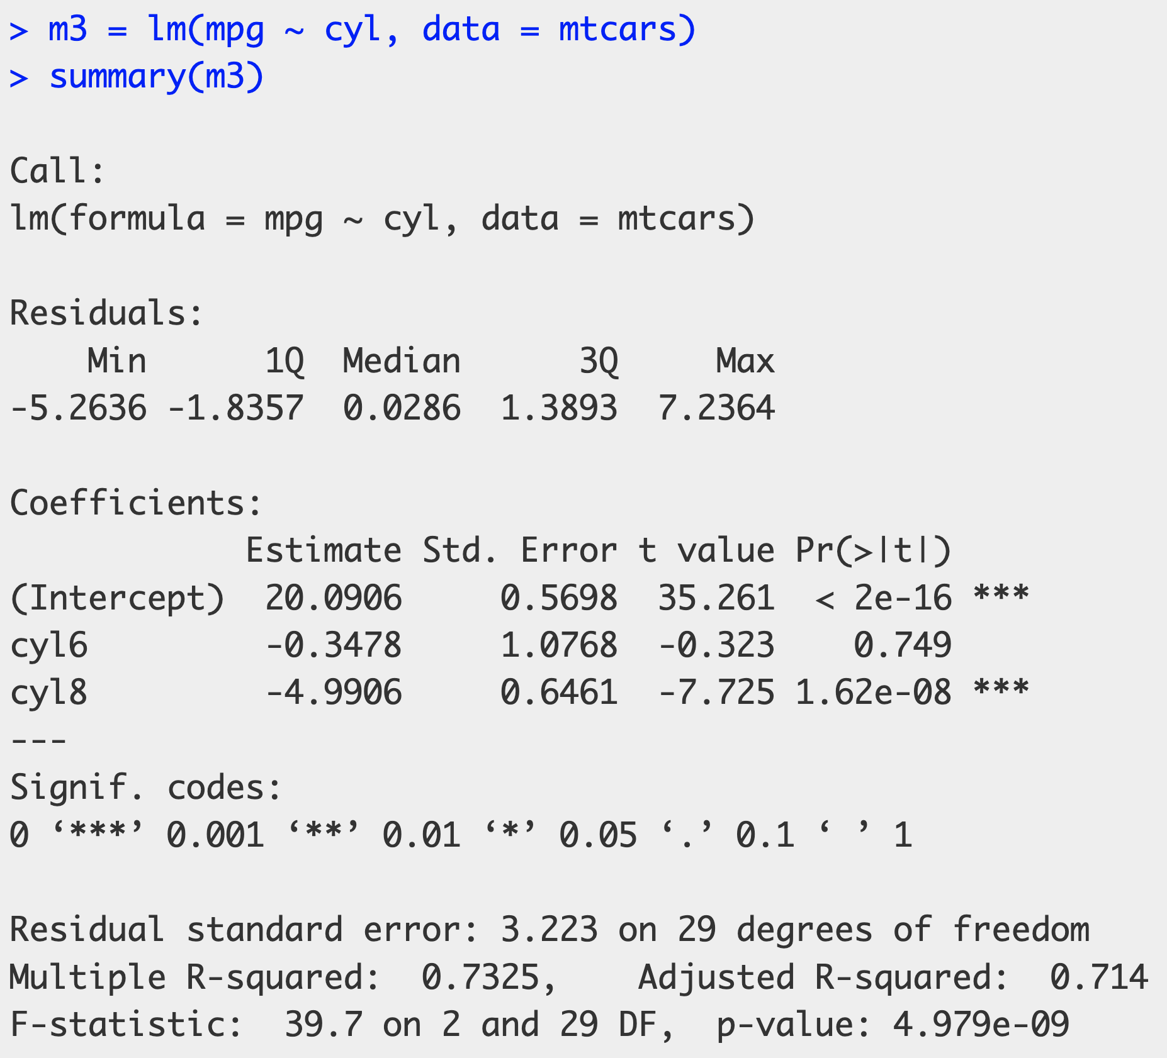
Notes:
We will return to the surgery example shortly, but for simplicity, let’s look at the coefficients from our mtcars model. We can see that 4-cylinder engines get about 27 miles per gallon, while 6-cylinder engines get about 7 mpg less, and 8-cylinder engines get about 11 and a half mpg less than 4-cylinder engines.

Slide 11
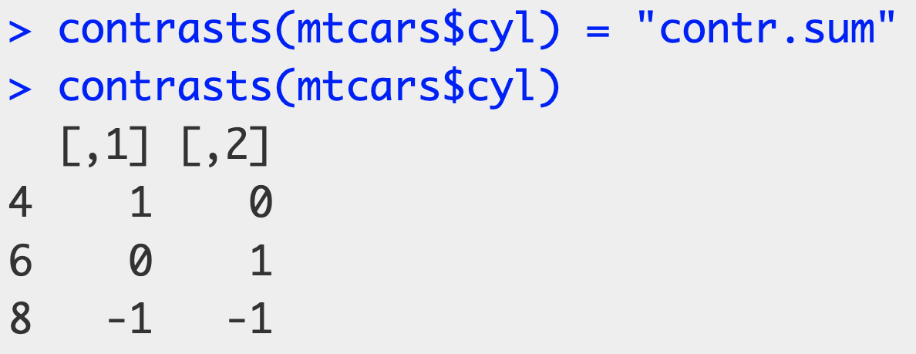
Of note for equity are sum contrasts, aka deviation contrasts, aka effect coding
Notes:
Sum contrasts don’t use a category level for a reference level, but instead use the grand mean of all the levels as the reference point. This is accomplished by having each column in the coding matrix sum to 0. Thus, the coefficients from the model become deviations from the grand mean.

Slide 12
4 cyl
6 cyl
Notes:
So we can see that the coefficients are different using sum contrasts, which makes sense because we’re looking at difference from the grand mean of the three cylinder types. The intercept is the grand mean. Since the coding matrix is set up to sum to zero, the levels’ coefficients must also sum to zero, so the “missing” 8-cylinder coefficient is simply the value that allows the other coefficients to sum to zero; in this case, that is about -5.4. Now stop for a moment and consider: if a consumer of these results didn’t know about coding schemes, what would they take away from the differences in coefficient values?

Slide 13
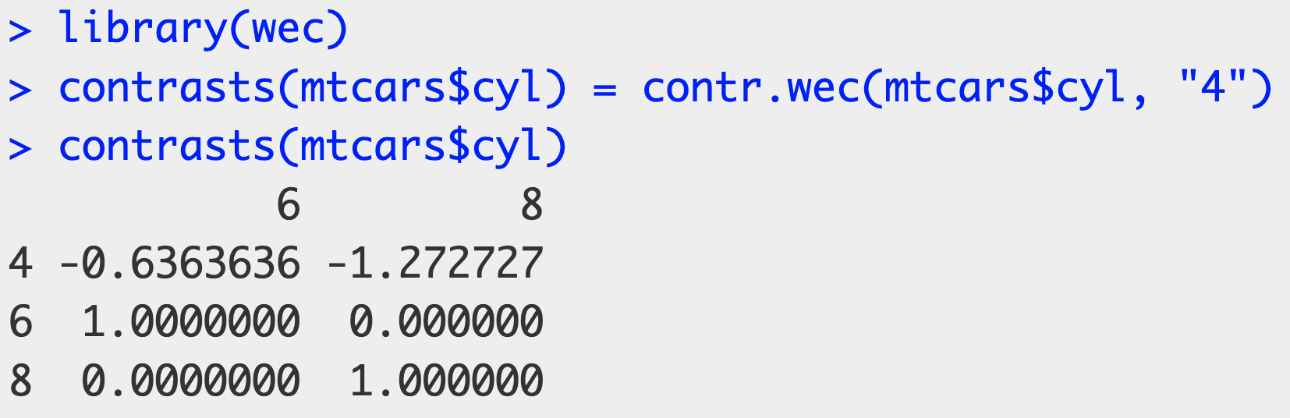

Weighted effect coding looks at the sample mean instead of the grand mean
Nieuwenhuis, et al. 2017. The R Journal 9(1):477-485.
Notes:
Weighted effect coding, which is a special case of sum contrasts, weights each category level by its sample size. This approach is not built into base R, so the wec package on CRAN provides a simple way to set it up. You have to specify which category level will be “omitted” in the contr.wec function—it won’t be omitted from the model, but it will be from the coefficients presented in the results.

Slide 14
Notes:
Now the intercept is the sample mean, and the coefficients are deviations from that sample mean. The missing category, 4-cylinder engines, is again the value where the other coefficients will sum to 0, so about 5.3.

Slide 15
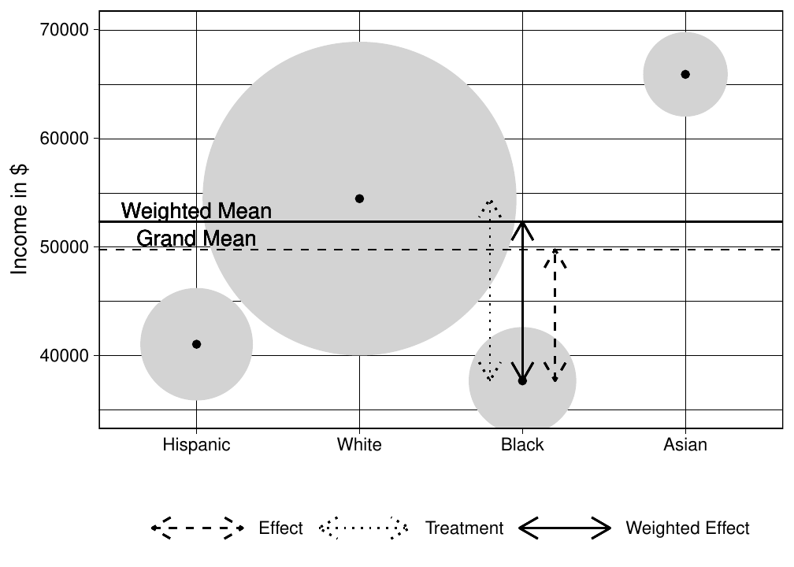
Sum
Nieuwenhuis, et al. 2017. The R Journal 9(1):477-485.
Notes:
The practical differences of these coding schemes can be seen in this example from the wec package article in the R journal. It shows the relationship between race and ethnicity group and income in US dollars, where the size of the circles represent the sample size for each group. The sample mean is shown as the solid horizontal line, and the grand mean of the four groups is shown as a dashed horizontal line. The three vertical double-ended arrows show the effect size between groups based on the coding scheme.

Slide 16
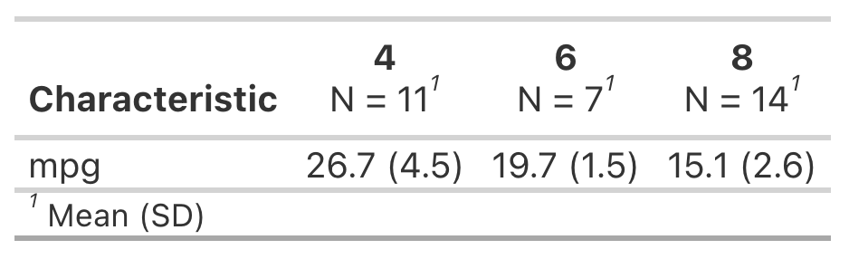
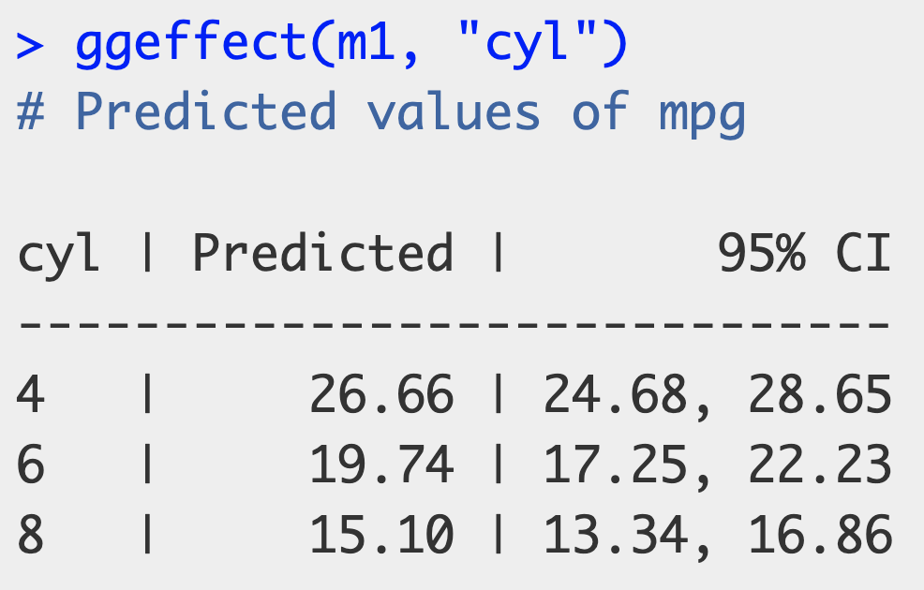
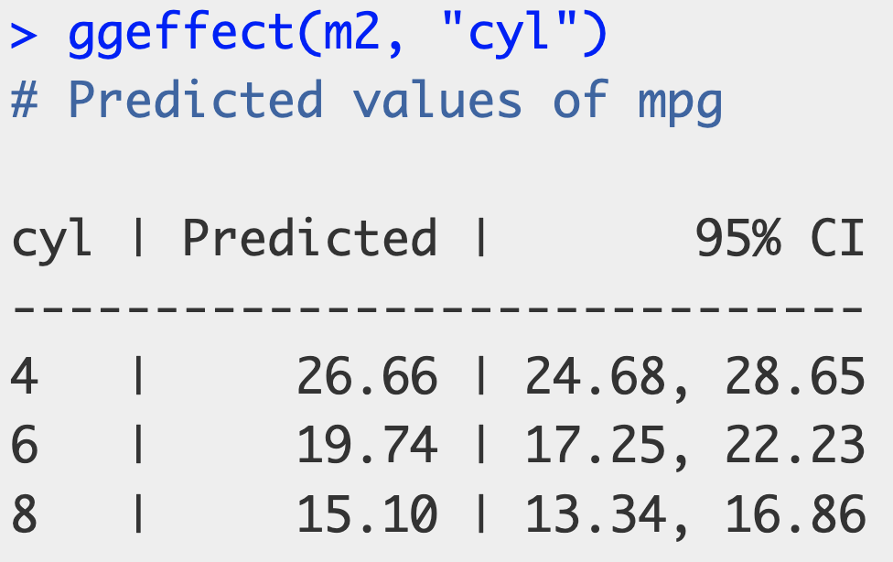
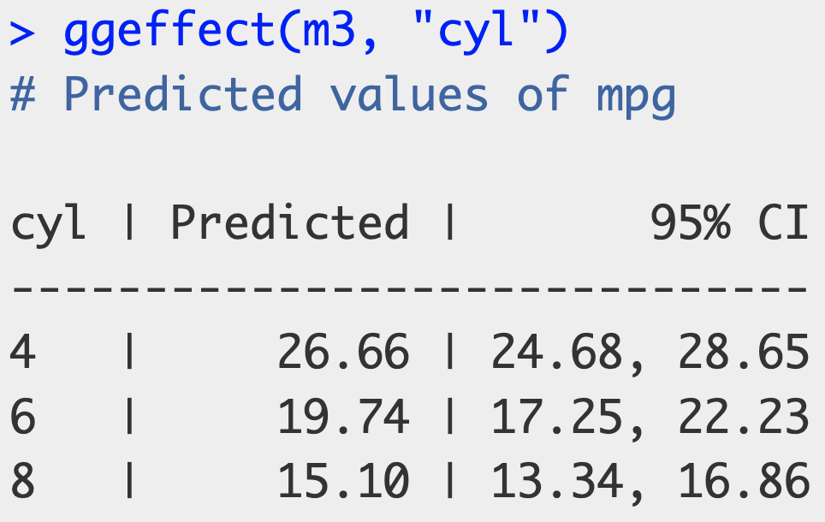
So which contrast/coding scheme is correct?
Predicted results acquired using the ggeffects package.
Notes:
So which coding scheme is correct? We can look to the descriptive statistics to see which model comes closest.

Slide 17
So which contrast/coding scheme is correct?
Predicted results acquired using the ggeffects package.
Notes:
And when we do that, we can see that the predicted values are all identical, regardless of coding scheme used.

Slide 18
So which contrast/coding scheme is correct?
Treatment Contrasts
Sum Contrasts
Weighted Effect Contrasts
Tables created with gtsummary::tbl_regression()
Notes:
So when we consider all these different odds ratios, and their different inferences for whether our care is equitable, we should always remember that they all lead to the same predictions, regardless of what the regression table shows.

Slide 19
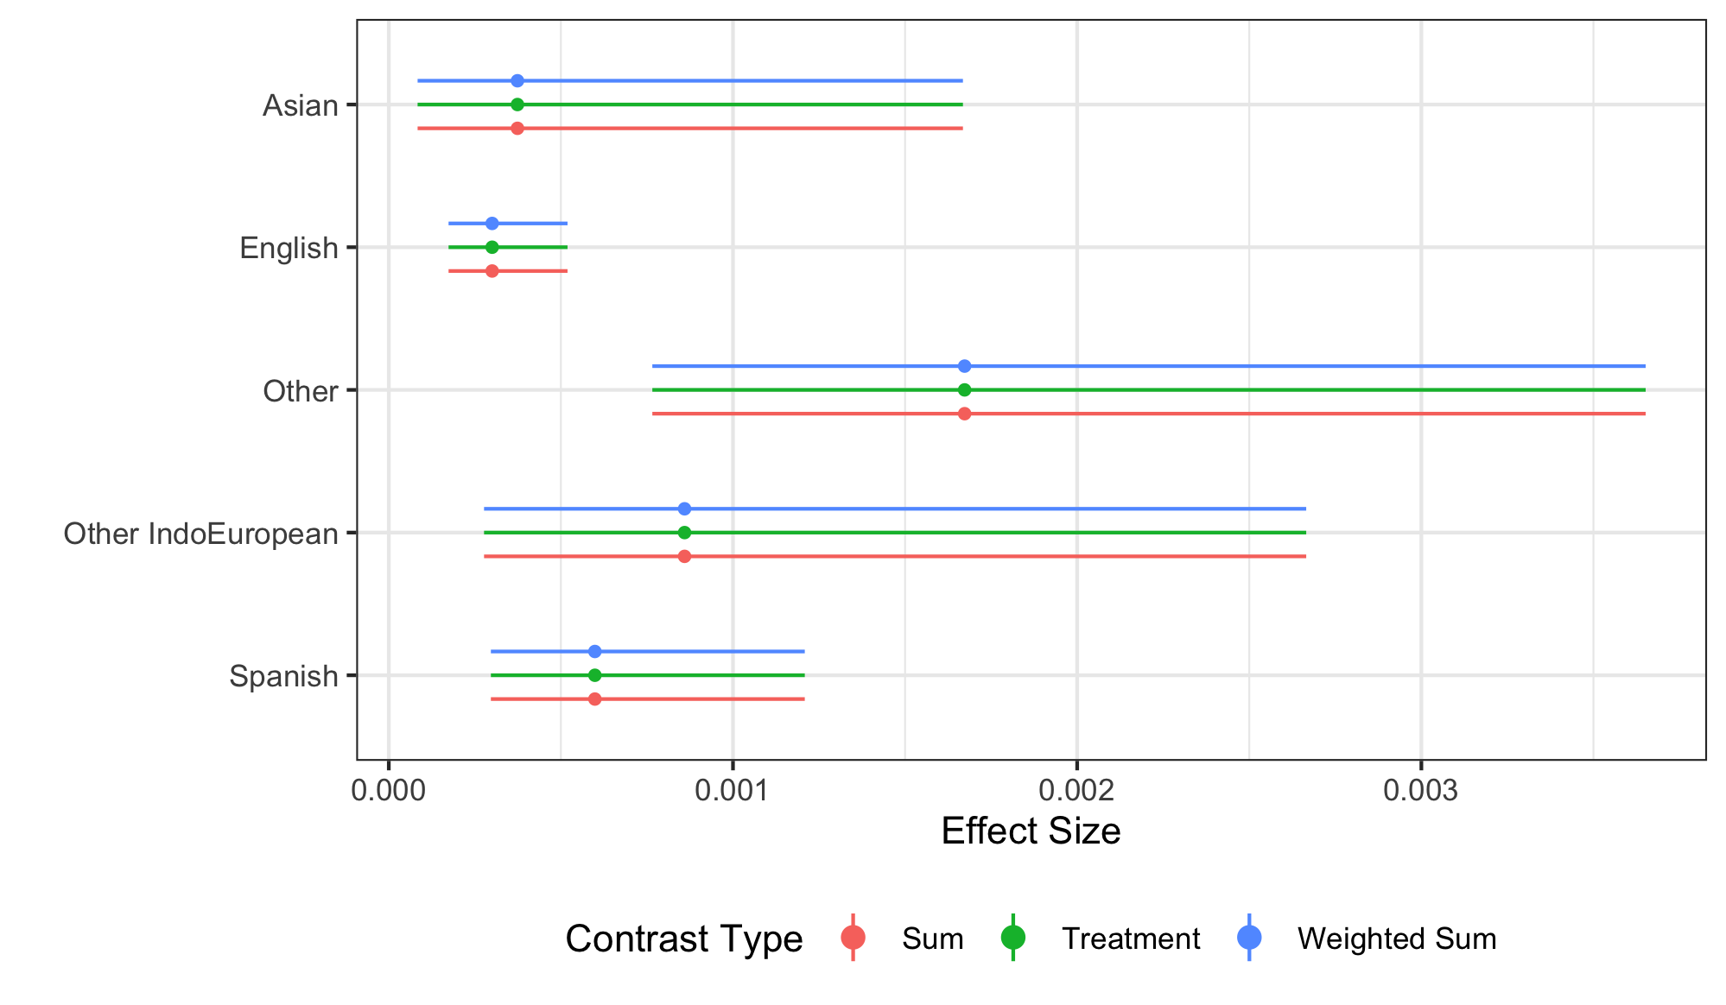
Marginal effects will be the same regardless of coding scheme and should always be used (esp. with odds ratios):
Marginal effects results from the ggeffects package; see emmeans and marginaleffects packages also.
Notes:
So it is important to note that the marginal effects for each coding scheme are exactly the same, since underneath it all, we are still talking about the same model, the same data, and the same variables.

Slide 20
Our choice of reference point affects the conclusions that can be drawn about inequities, as well as the value judgements on what is, as well as what should be, standard or normal.
When you have a categorical exposure with no natural order or control, the choice of contrast is an ethical choice, not a statistical one.
R’s default treatment contrasts, often make white, English-speaking males the reference group.
By using sum contrasts, either regular or weighted, we are explicitly decentering away from a single referent.
Always present marginal effects.
Notes:
This typically supports the dominant social narrative, which is known to be inequitable. This places importance on the privileged cohort and fails to change the rhetoric of what is considered to be the norm.
However, comparing to a grand mean and presenting results (only) as odds ratios can dilute the overall effect, minimizing inequities.
Thus, marginal effects should always be presented alongside regression coefficients or odds ratios.

Slide 21



Any questions?
Data and example based on
Chicoine et al. 2025.
Notes:
Thank you for listening!

